Slide 1
final presentation
Team login_failed
s1250052 Naoki Sahara
S1250116 Keisuke Takemura

Slide 2
Introduction member
s1250052 Naoki Sahara
S1250116 Keisuke Takemura

Slide 3
Introduction system
This project is to build road plan(Detection and management of all intersection, Shortestpath K-th shortest path, Suggestion of optimal road construction Detection of high way)

Slide 4
Implemented Algorithm
Algorithm be published on course site
Dikestra algorithm
Bubble sort

Slide 5
Development Environment
Language : C++
Compiler : g++7.4.0
Reason : Grammar is similar to C language. In addition, there are many useful functions more than C language

Slide 6
Deliverable
Task1 Complete
Task2 Complete
Task3 Complete
Task4 Complete
Task7 Complete(a little error)
Task8 Complete
Any other Not Complete

Slide 7
Task1
Use algorithm published course site
Computational efficiently is O(1)

Slide 8
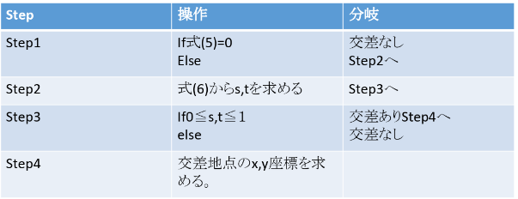
flowchart

Slide 9
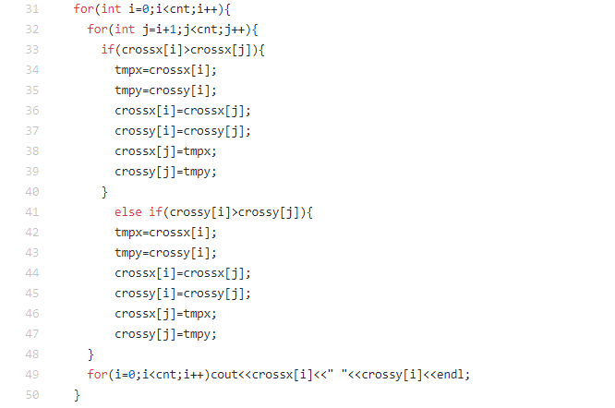
Task1 :Sourse code

Slide 10
inputsample 1
Input sample1 in the course site and output result and visualize
Inpu: 4 2 0 0
0 0
5 5
2 5
7 1
1 2
3 4
Output: 3.66667 3.66667

Slide 11
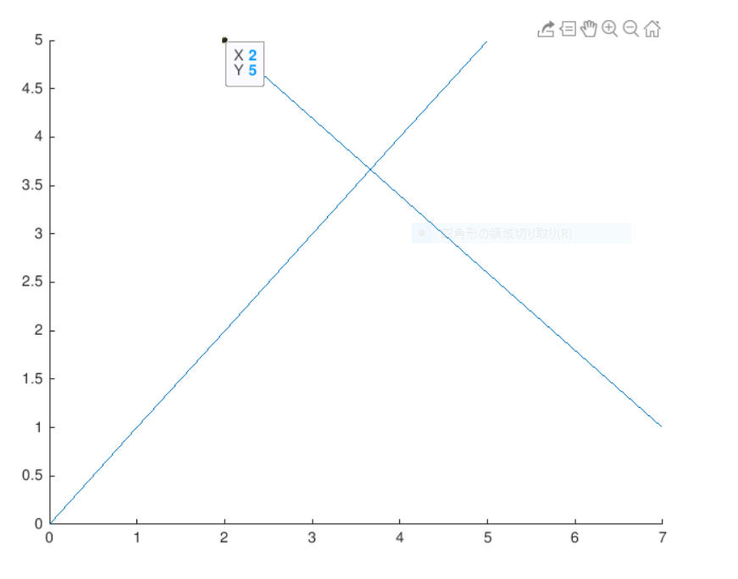
Visualize1

Slide 12
Input sample2
Use input sample 3 in the course site, and output result, visualize
input：4 2 0 0
5 5
9 5
4 7
7 1
1 2
3 4
output：NA

Slide 13
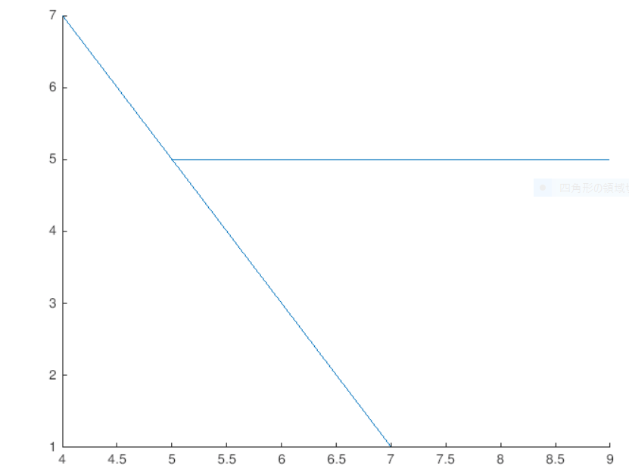
Visualize

Slide 14
Task2
Use bubble sort to sort intersection
Computation efficiently is O(n^2)
Disadvantage: Computation efficiently is bad
Use vector that easy to access

Slide 15
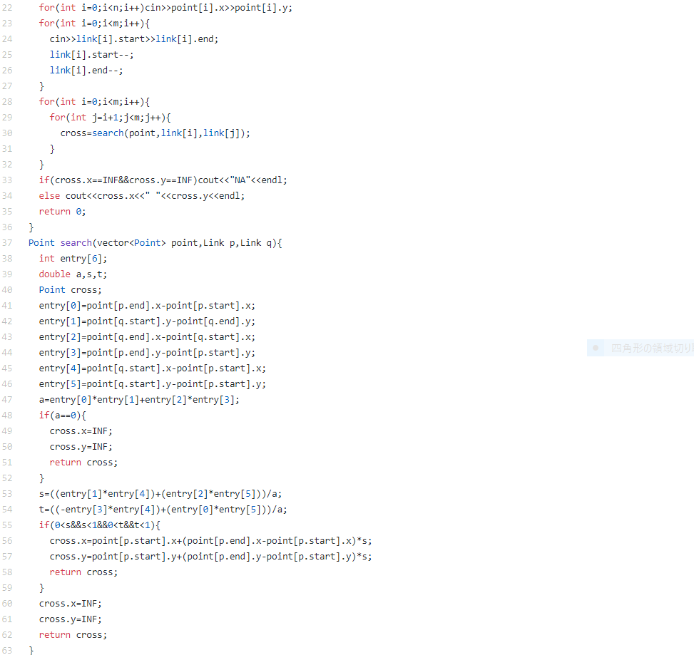
Task2: source code

Slide 16
Input sample１
Use input sample in the course site , output result and visualize
input：6 5 0 0
0 0 3 5
2 5 4 6
4 7 Output 3.66667 3.66667
5 5 4.86885 2.70492
1 4 5.86957 3.26086
1 6
2 5

Slide 17
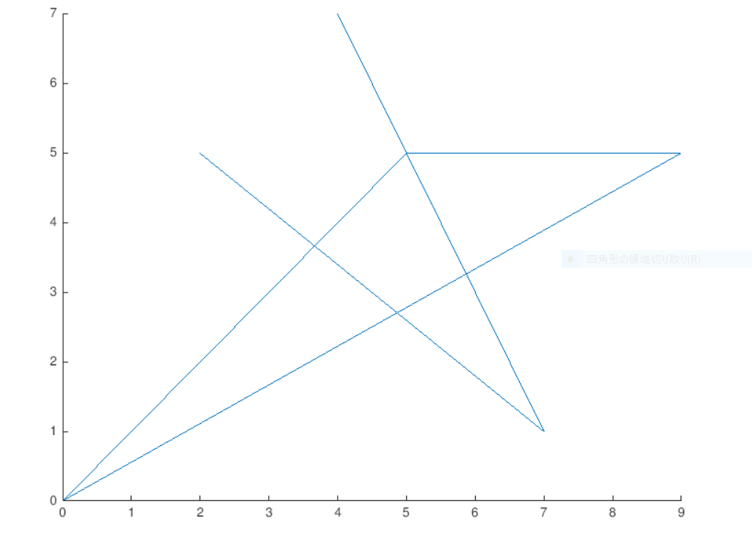
Visualize

Slide 18
Input sample 2
Create and use test data and output result and visualize
Input：7 8 0 0 1 2 Output：2 4
0 0 1 3 3 4
2 2 1 4 4 2
4 0 2 6 4 3
0 4 2 7
4 4 3 5
2 5 4 5
5 2 6 7

Slide 19
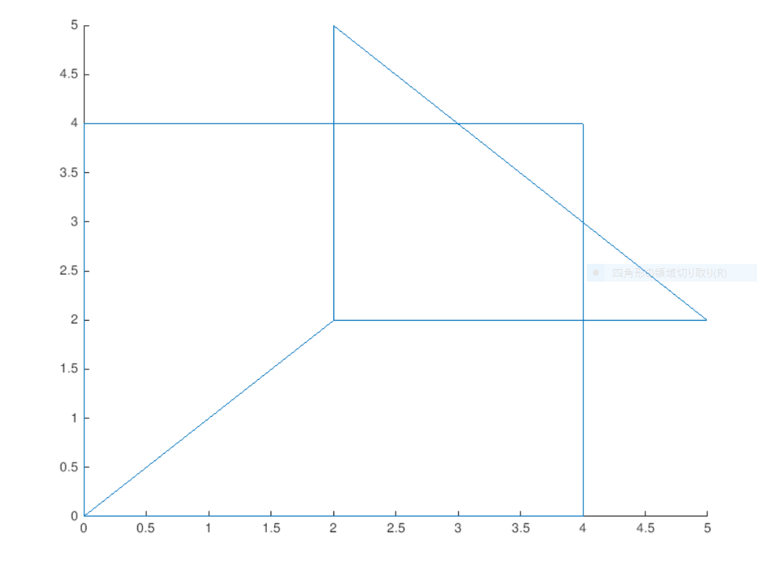
Visualize

Slide 20
Phase1-3
Create the following data structure
Struct node{
double mincost;
int from;
bool done;
vector<double> cost;
vector<int> to; }

Slide 21
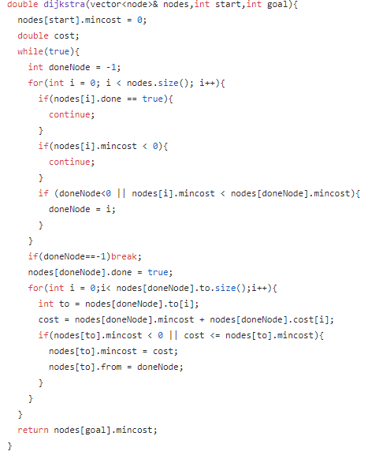
Phase1-3
Use the Dijkstra algorithm

Slide 22
Phase1-4
Follow the “from” data in the node structure for output the shortest path
for(int i = goal; i != start; i=node[i].from){
path.push_back(i); //push the data from goal to start
} path.push_back(start);
for(int i = path.size()-1; i >= 0; i--){
cout << path[i] << endl; //output
}

Slide 23
Task 7
Cover all pattern (eg. Road x cooperate is not change, Road y cooperate is not change, and any other)
Calculate most shortest distance and that coordinate using orthogonal straight line.
If coordinate is out of range(Not on the road), most shortest distance is more closer point
Computation efficiently is O(m*p)
Disadvantage : source code is very long and hard to see, and very complex.
Hardship: -a+b and b-a are different.

Slide 24
Task 7 Possibility
 | Road and orthogonal straight line cross on the road | Road and orthogonal straight line don’t cross on the road
Road y-coordinate is not change | ① | ②
Road x-coordinate is not change | ③ | ④
Any other | ⑤ | ⑥

Slide 25
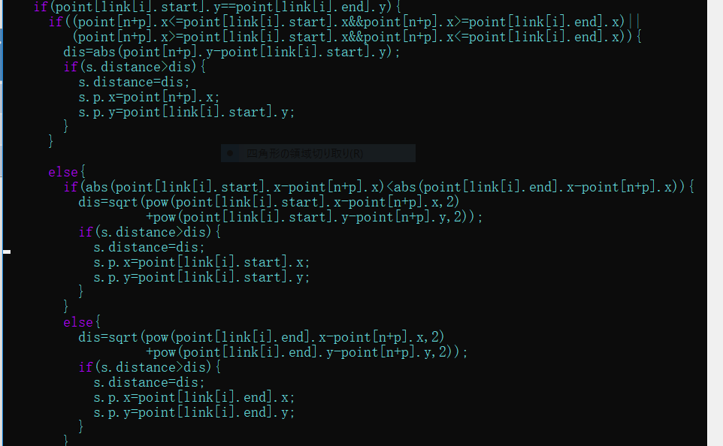
Task 7 Source code about ① and ②

Slide 26
Discribe
First if() check road y-coordinate is not change.
Next if() check that whether or not orthogonal straight line cross road.
If normal vector cross road, calculate next formula
dis = √((road ‘s)y-(new point’s)y^2)
・ If normal vector don’t cross road compare next two formula.
|(road start)x-(new point)x| and |(road end)x-(new point)x|
calculate the distance to the nearer point next formula
Dis=√(x-x1)^2+(y-y1)^2
・If dis is shorter than s.distance, dis is s.distance.

Slide 27
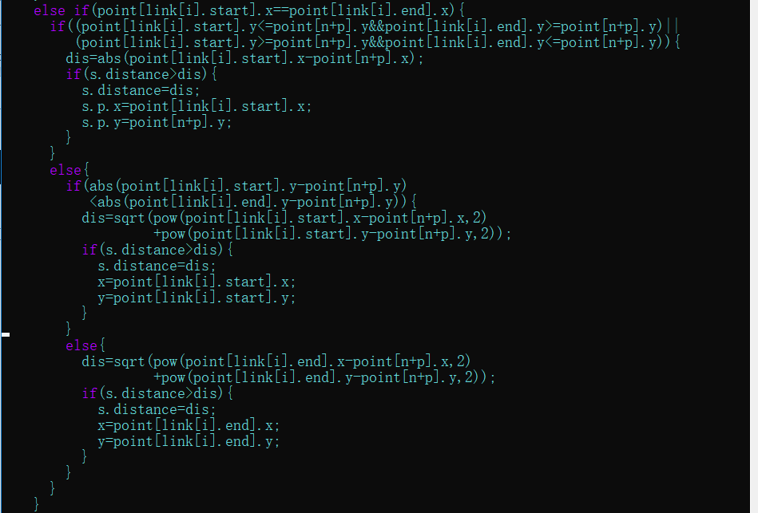
Task 7 source code about ③ and④

Slide 28
Discribe
Almost same as source code ① and ②, but x become y

Slide 29
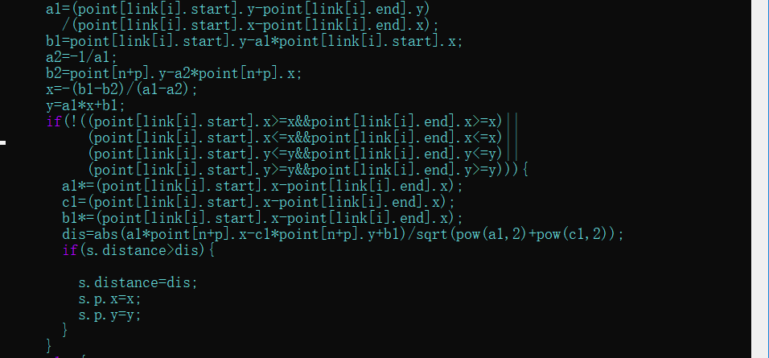
Task 7 source code ⑤

Slide 30
Discribe
Calculate road’s function (y=a*x+b) and orthogonal one.
Next, calculate intersection’s-coordinate.
If There is intersection on the road, road’s function change to a*x+b*y+c=0 and calculate distance use formula of distance of point(x,y) and straight line(a*x+b*y+c=0).
Dis=|a*x+b*y+c|/√(a^2+b^2)
If dis is shorter than s.distance, s.distance is dis.

Slide 31
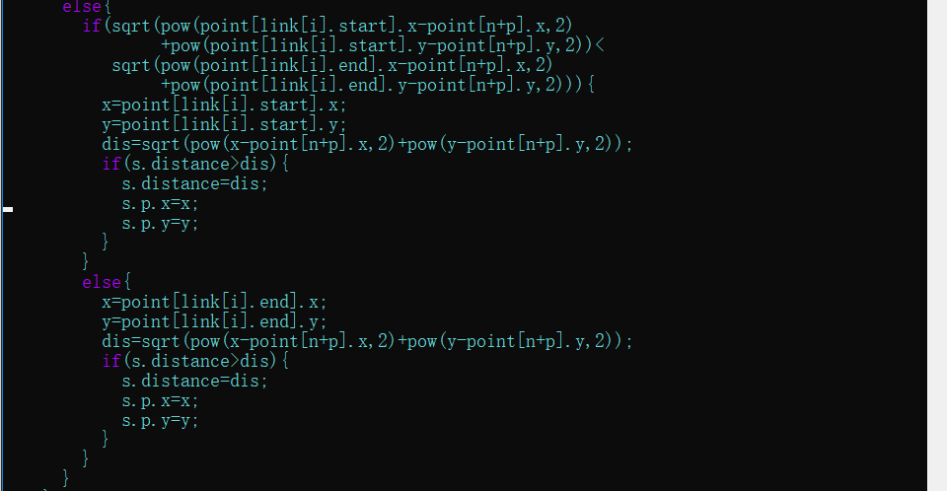
Task 7 Source code about ⑥

Slide 32
Discribe
Compare distance between both ends and point.
Dis is shorter one.

Slide 33
Task 8
Algorithm:
DFS(depth-first-search)
Details:
First, each node has two data(pre, low).
Vector<int> pre(n,0) // store the pre-order value
Vector<int> low(n,0) // store minimum pre-order value of accessible node
Procedure
Selecting one node
If the next node hasn’t visited, set the pre and low of that node
If the next node has already visited, comparing the low value of current node and next node, then set the minimum one as current one
Each time finishing the dfs, updating the parent node

Slide 34
Task8
Int def(){
low[current] = pre[current] = cnt++; //set the low and pre
for(i=0;i<node[current].to.size();i++){
to=node[current].to[i];
if(!pre[to]){ //check the whether node has already visited or not
low[current] = min(low[current], dfs()) //set the minimum value
if(pre[to] == low[to]){ // get the bridge
bridge.push_back(make_pair(crr,to));
}
else if (from != to){ //update the parent node’s low value
low[current] = min(low[current], low[to];
}
}
return low[crr];
}

Slide 35
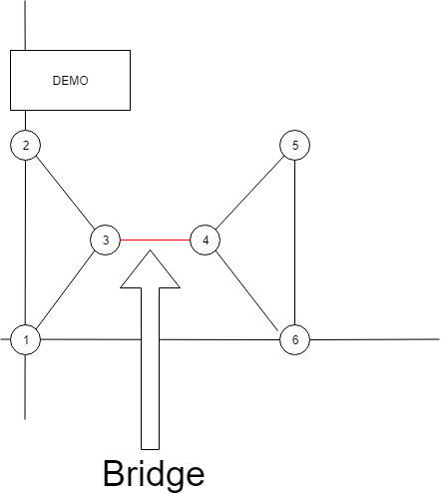
Task 8
DEMO:
Input data
6 7 0 0
0 0
0 10
1 5
2 5
3 10
3 0
1 2
2 3
1 3
3 4
4 5
5 6
4 6
Output data
3 - 4

Slide 36
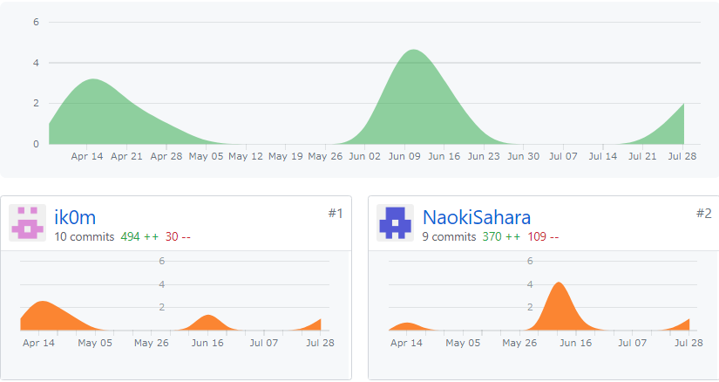
Contribution

Slide 37
Contribution: role play
Naoki Sahara: Task1,Task2,Task7
Keisuke Takemura : Task1,Task3,Task4,Task8

Slide 38
Contribution :Task 1
Member | Take time | Row | Efficiently
Keisuke Takemura | 5 | 42 | 8.4
Naoki Sahara | 4 | 64 | 16

Slide 39
Contribution :Task2
Member | Take time(hour) | row | efficiently
Naoki Sahara | 4 | 78 | 19.5

Slide 40
Contribution : Task3,4
Member | Take time | Row | Efficiently
Keisuke Takemura | 14 | 303 | 21.64

Slide 41
Contribution :Task 7
Member | Take time | Row | Efficiently
Naoki Sahara | 7 | 157 | 22.42

Slide 42
Contribution: Task8
Member | Take time | Row | Efficiently
Keisuke Takemura | 10 | 99 | 9.9

Slide 43
Consideration
Report, contact, and consultation is not enough.
Because we inexperience in development.
We need to more time for communicate team member out of class.
Schedule management is very important to finish all task.

